Slide 1
LEAF BLOWERS ARE HARMING PUBLIC HEALTH & WELL–BEING. WHAT TO DO ABOUT IT?
Material developed by:
Monty McDonald Chairman Bayview Village Environment Committee
Harold Smith, Member Toronto Noise Coalition,
Director Lytton Park Residents’ Org.

Slide 2
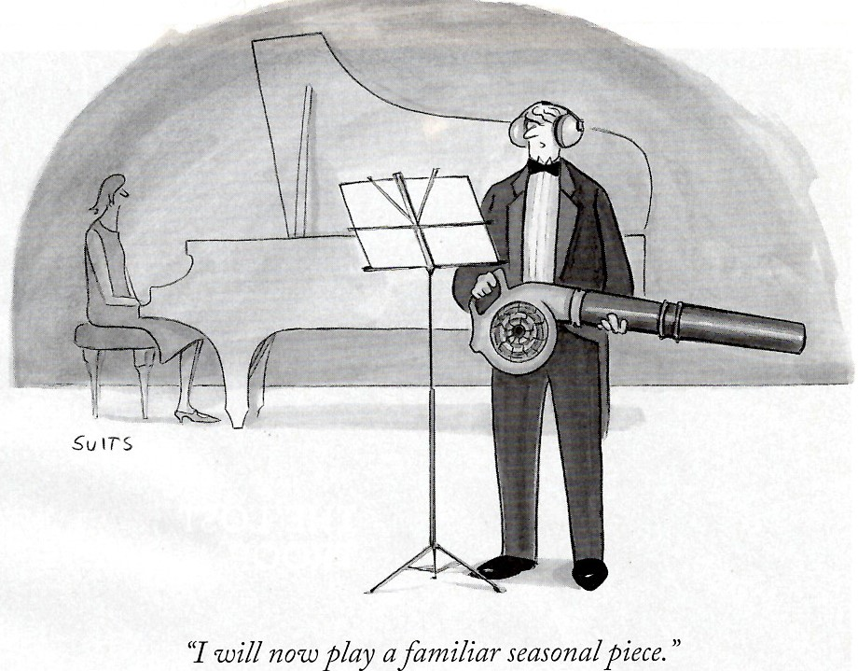

Slide 3
Situation on Gas Powered Leaf Blowers (GLB’s)
Many people in Toronto reluctantly accept the noisy, smelly GLB as an annoyance that comes with the times.
No City restrictions except time of day noise
Most people in California know the GLB is a serious threat to public health
85 cities in the state have banned their operation year round
Another 120 municipalities in the US have followed suit with restrictions or bans

Slide 4
COVID 19 provides Context for GLB Danger
It’s ALL ABOUT LUNG HEALTH!

Slide 5
Post Retirement: Monty’s Environmental causes
DRIVER: I love wilderness tripping, bird watching, fresh air
Invited to Chair the Bayview VillageAssociation (BVA) Environment committee (2,000 homes)
NEW Committee Mission: create awareness, involve residents, contractors and governments to ELIMINATE threats to safety, health and the environment AND through our actions influence improvements in the GTA.
Top of our list: AIR pollution: eliminate highly polluting 2 stroke engines driving community lawn and garden equipment including GLB’s
Partnered with Cdn Tire trade-in for electrical alternatives at best sale price

Slide 6
Next : eliminate contractor GLB operations in summer (contractors mow 75% of B.V. residents’ lawns)
30% of fuel goes through unburned becoming a toxic aerosol for us to breath
No brainer to ban them in summer:
No leaves on ground
Children home from school out doors
High Smog Months
Residents are out doors
Leave clippings on lawn as mulch
Sweep clippings from paved areas WITH A BROOM

Slide 7
Response from the 75% of Bayview Village residents who use mowing contractors
We asked them to tell contractors to not use GLB’s in summer via website, newsletters, face to face, try our Student Green Practices lawn care.
Only 10% success rate after 10 years trying:
Health of neighbours is not as important as a pristine lawn
“if GLB’s are that bad why doesn’t the City ban them?”
Mowing contractors won’t listen, not aware of health hazard to employees
“We have to go after the City”: Start with our area Councillor Shelley Carroll …. to convince her to recommend a summer ban to City Council

Slide 8
Shelley Carroll ‘s Members Motion to City Council September 2020
Recommend ban GLB’s in summer months for all operations as a first of several steps
Accepted by Council and sent to Toronto Public Health (TPH ) and City Manager to study impacts and recommend regulations
DUE DATE MAR 30, 2021
We strongly urged that TPH “ learn from CALIFORNIA and do the right thing”

Slide 9
SO, WHY CALIFORNIA?
We interrupt this program for an unpaid political announcement

Slide 10
California has a fragile climate: moist Pacific air piles up against the mountains + industrial pollution+ sunlight= photochemical smog 1950’s: large percent of population suffered from lung diseases because of smog (below typical day in Los Angeles)

Slide 11
Late 1950’s California scientists discovered unburned gasoline (VOC’s ) and Nitrogen oxides were the main cause of SMOG Getting worse with growing population and more cars
California aggressively tackles air pollution
Governor gets Federal approval to set State Air Quality Standards
Formed California Air Resources Board (CARB)
In 1966 CARB sets tailpipe emission standards auto makers must meet to sell cars in the state.
CARB commissions CalTech and UCLA to work with auto industry to develop pollution control technology (e.g. Catalytic Converter).
And with Oil industry to reformulate gasoline
VOC’s

Slide 12
1966 Governor Ronald Reagan Sign’s California Air Resources Act
CARB has raised the bar on tailpipe standards every year since
The rest of the western world has followed suit on auto pollution controls
A new automobile in 2020 creates 99% less pollution than a new 1966 automobile
The world owes California a great debt : they are leaders in air pollution control

Slide 13
In the 1980’s CARB turned its attention to highly polluting 2 stroke engines used in lawn and garden equipment
CARB determined that small engine exhaust creates more ozone than the 7 million cars in the state
Technology cannot make pollution improvements in 2 cycle engines like were done with automobiles: MUST CONSIDER BANS
Medical studies: gasoline contains carcinogens and toxic dust from GLB’s can be as bad as unburned fuel, smog
In July 2001, Dr Sheela Basrur, Medical Officer Toronto Public Health, citing CARB’s medical research recommended GLB’s be banned from May through September. Sheela did exemplary work managing City through SARS. She was awarded Order of Ontario on her death bed in 2008
Rejected by Toronto City Council!!!

Slide 14
THE PROBLEM WITH GASOLINE POWERED LEAF BLOWERS (GLB’s) #1 UNBURNED FUEL
GLB’s deploy a two stroke Engine as do other light weight garden machines ( edge and hedge trimmers, chainsaws)
GLB’s have High power to weight ratio, and can run in any position
But 30% of gas+oil fuel goes through engine unburned !
This unburned fuel and exhaust forms a TOXIC aerosol for us to breath

Slide 15
Unburned=30% of fuel in

Slide 16
GASOLINE HARMS HUMAN HEALTH
Many gasoline components are known carcinogens ( e.g.: benzene, butadiene, formaldehyde).
There is no safe exposure threshold for these chemicals:
Industrial processes using these carcinogenic chemicals have strict Ontario regulations (OCCUPATIONAL HEALTH AND SAFETY ACT [OHSA]) on worker exposure to them
E.g regulation on BENZENE: used to manufacture styrene / polystyrene. The chemical concentration must be less than 0.5 ppm (parts per million) time weighted average in air in the workplace.
Operators near GLB exhaust are exposed to dangerous levels of such chemicals. The 30% of unburned fuel in the exhaust calculates to 18,750 ppm concentration in the air in his/her workplace!
If 10% of the fuel contains carcinogens, 10% X 18,750 = 1875 ppm which is 3,750 times the regulation . Why isn’t Ministry of Labour monitoring the GLB workplace as they do in factories??

Slide 17
What about Citizens near an operating GLB?
They will be overexposed as well!
If you smell the fumes from a GLB, you have ingested these chemicals!
Our Noses can’t detect most chemicals below 300ppm

Slide 18
THE PROBLEM WITH GASOLINE POWERED LEAF BLOWERS (GLB’s) #2 DUST
The propelling air from the leaf blower travels at 200 – 250 Km/hr pulverizing what it hits into fine dust, finer than found in nature (fine like talcum powder)
It can stay airborne for days.
Dust (PM or particulate matter) is so fine (less than 10 microns), it gets past the protective cilia in our airways and lodges in our lungs.

Slide 19
PARTICULATE MATTER (PM) IS ALSO A HAZARD TO HUMAN HEALTH
The pulverized yard dust PM contains animal feces, bacteria, moulds, fungus, fertilizer, pesticides.
Contractors blow lawn clippings off lawn & down the street
Street dust contains carbon black from tire wear and asbestos from brake lining wear, both are carcinogens in our lungs.
Very fine PM can enter our blood stream through the lungs.

Slide 20
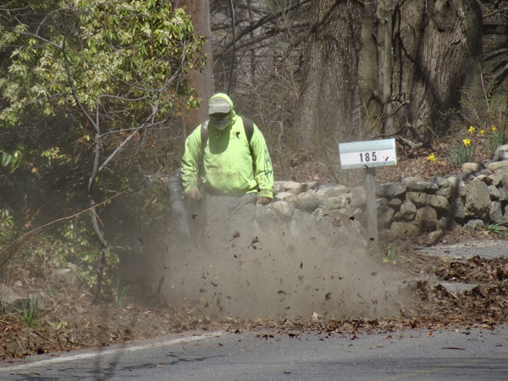
This operator is smart enough to protect himself from the dust with a mask but it does not stop the exhaust fumes entering his lungs

Slide 21
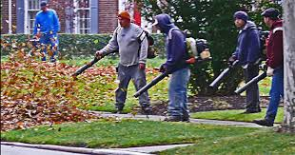
ATTACK OF THE LEAF BLOWERS: OPERATORS USE THEM IRRESPONSIBLY. Note NO DUST MASKS OR HEARING PROTECTION

Slide 22
GLB POLLUTION AND LUNG DISEASES
Air Pollution increases the suffering of those who have lung disease
Asthma
COPD (chronic obstructive pulmonary disease)
Chronic Bronchitis
Emphysema
Lung Cancer
Pneumonia
Most susceptible are the elderly and young children whose bodies are growing
GLB’s cause more air pollution in residential neighbourhoods than any other regular source:

Slide 23
THE PROBLEM WITH GASOLINE POWERED LEAF BLOWERS (GLB’s) #3 NOISE
The Most Pervasive Obnoxious Noise source in Toronto
Up to 115 decibels of low frequency sound
Low frequency sound has great penetrating power going through walls and many types of hearing protection devices
Exposure above 75 decibels over extended time periods results in hearing loss
Other long-term health impacts of noise
high blood pressure and ischemic heart diseases
sleep disturbance,
mental health effects.

Slide 24
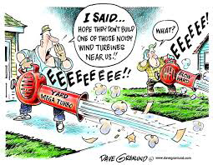

Slide 25
The Madness Continues
City workers use GLB’s to clean parking lots, parks, pathways instead of deploying rakes and brooms.
This adds to the City PM load
Construction contractors save time in cleanup using GLB’s instead of brooms or vacuum cleaners. GLB’s disperse construction debris and dust (more fine PM) from their work sites into surrounding neighbourhoods.
Inhaling silica dust from stone and concrete cutting and grinding causes Silicosis, an incurable disease.
fiber glass insulation, drywall dust are lung irritants

Slide 26
RECOMMENDED TIME SCHEDULE TO PROTECT PUBLIC HEALTH
Step 1: ban GLB operations for lawn maintenance from May through September
They should not be used to clean streets, driveways or sidewalks year round
They should be banned from construction sites for dust cleanup year round
City Workers should stop using GLB’s year round
Step 2 : For the Fall and Spring operations assess further restrictions on how all types of leaf blowers are to be used (including battery Op)
Step 3: Ban GLB’s for lawn maintenance in the Fall & Spring as well (electric, battery operated allowed)

Slide 27
REGULATIONS MUST BE ENFORCEABLE!
LESSON LEARNED FROM ANTI DUST BYLAW (SEPT 2018) FOR RESIDENTIAL STONE CUTTING toxic stone dust must be captured by wet sawing or vacuum collection. The dust is mostly silica. If inhaled, it causes Silicosis an incurable disease that can lead to lung cancer
Residents reported violations to 311 : testimony, videos, pictures, stone dust on windshields and windows is not admissible evidence
Bylaw enforcement officer must witness the actual cutting to lay a charge
contractors know this and flaunt the law
A GLB BAN: IT SHOULD BE A VIOLATION FOR CONTRACTORS TO BE IN POSSESSION OF A GLB IN THEIR VEHICLES OR AT THE WORKSITE
Bylaw enforcement: levy a fine ($1,000) if contractor has a GLB whether operating or not
Such enforcement penalties will get around the grass cutting industry very quickly and discourage violations
Testimonies with photos by affected residents should also be accepted as evidence of violation

Slide 28
WHEN, WHAT will TPH and Toronto City Manager Recommend ?? March 30 was 9 months ago

Slide 29
WHEN, WHAT will TPH and Toronto City Manager Recommend ?? August 2021 Toronto Environment & Energy Division (EED) wrote: In 2017 EED reported to City Council (2017.PE19.4) that based on available research, not enough evidence existed to justify further restricting two-stroke engines on environmental or health grounds and we do not believe there have been sufficient developments since to warrant an urgent change in direction. ..So California has it all wrong????? …read the 20 yr old Sheela Basrur File!!

Slide 30
If you believe us and not EED, what can you do?
Trash your GLB,
Replace it with Battery Operated for Fall if you must
Tell contractors not to use GLB’s
Sweep your own driveway, leave grass clippings on the lawn
Offer to sweep your neighbour’s driveway
Wear a NIOSH 95 mask if GLB operating next door
Share this info with neighbours
Complain to your City councilor of the 4th largest city in North America:
Why the delay?!
Why study what 200 cities already know?
and why EED who have displayed total ignorance and not TPH ??

Slide 31
Dec 2021: Disappointing Statement from Toronto Public Health !!
“Toronto Public (TPH) has reviewed the analysis of the Environment and Energy Division.”
“TPH concludes that the Noise, Dust and Air pollution resulting from the use of small engines (leaf blowers) constitutes a nuisance that can be addressed through municipal bylaws”
“But not public health harm that the Health Protection and Promotion Act would address”
SO CALIFORNIA HAS IT ALL WRONG??????!!!
AND SHEELA BASRUR of TPH HAD IT ALL WRONG 20 YEARS AGO??!!

